Slide 1
Introduction to Cloud computing
Prepared by:
AVITA KATAL
ASSISTANT PROFESSOR(SS)
Systemics Cluster
SCS,UPES

Slide 2
Contents
Vision of cloud computing
Cloud definitions
Humble opinion
3.1. Central ides
Utility Computing
Service Oriented Architecture
Service level Agreements
3.2. Characteristics of Cloud Computing
Scalability and Elasticity
Availability and Reliability
Manageability and Interoperability
Performance & Optimization
Accessibility and Portability

Slide 3
1. Vision of Cloud computing
In 1969, Leonard Kleinrock, one of the chief scientists of the original Advanced Research Projects Agency Network (ARPANET), which seeded the Internet, said:
“As of now, computer networks are still in their infancy, but as they grow up and become sophisticated, we will probably see the spread of ‘computer utilities’ which, like present electric and telephone utilities, will service individual homes and offices across the country.”
Notes:
This vision of computing utilities based on a service-provisioning model anticipated the massive transformation of the entire computing industry in the 21st century, whereby computing services will be readily available on demand, just as other utility services such as water, electricity, tele-phone, and gas are available in today’s society. Similarly, users (consumers) need to pay providers only when they access the computing services. In addition, consumers no longer need to invest heavily or encounter difficulties in building and maintaining complex IT infrastructure.

Slide 4
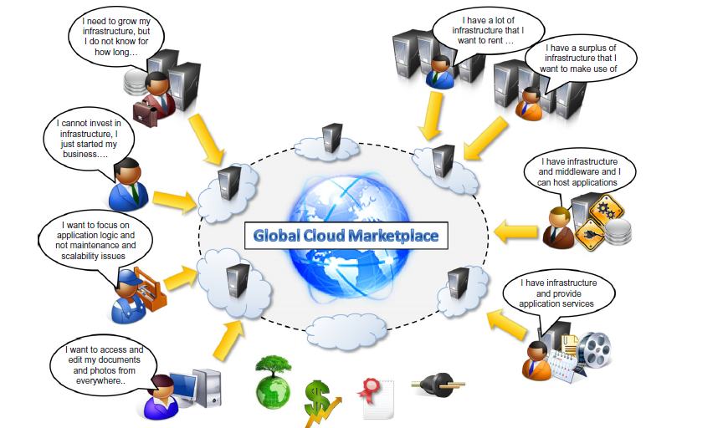

Slide 5

2. Cloud Definitions
Definition from NIST (National Institute of Standards and Technology)
Cloud computing is a model for enabling ubiquitous, convenient, on-demand network access to a shared pool of configurable computing resources (e.g., networks, servers, storage, applications, and services) that can be rapidly provisioned and released with minimal management effort or service provider interaction.
This cloud model promotes availability and is composed of five essential characteristics, three service models, and four deployment models.

Slide 6

2. Cloud Definitions contd…
Definition from Berkeley
Cloud Computing refers to both the applications delivered as services over the Internet and the hardware and systems software in the datacenters that provide those services.
The services themselves have long been referred to as Software as a Service (SaaS), so we use that term. The datacenter hardware and software is what we will call a Cloud.
When a Cloud is made available in a pay-as-you-go
manner to the public…… The service being sold is Utility Computing.

Slide 7

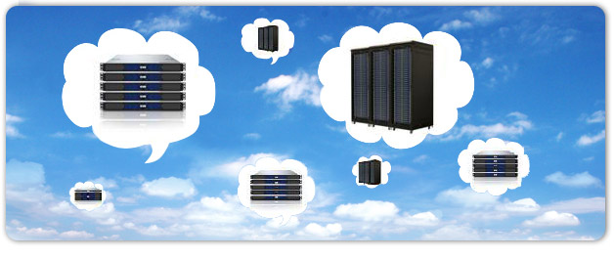
2. Cloud Definitions contd…
Definition from Buyya
A Cloud is a type of parallel and distributed system consisting of a collection of interconnected and virtualized computers that are dynamically provisioned and presented as one or more unified computing resources based on service-level agreements established through negotiation between the service provider and consumers.

Slide 8

3. In Our Humble Opinion
Cloud computing is a paradigm of computing, a new way of thinking about IT industry but not any specific technology.
Central ideas
Utility Computing
SOA - Service Oriented Architecture
SLA - Service Level Agreement
Properties and characteristics
High scalability and elasticity
High availability and reliability
High manageability and interoperability
High accessibility and portability
High performance and optimization
Enabling techniques
Hardware virtualization
Parallelized and distributed computing
Web service

Slide 9
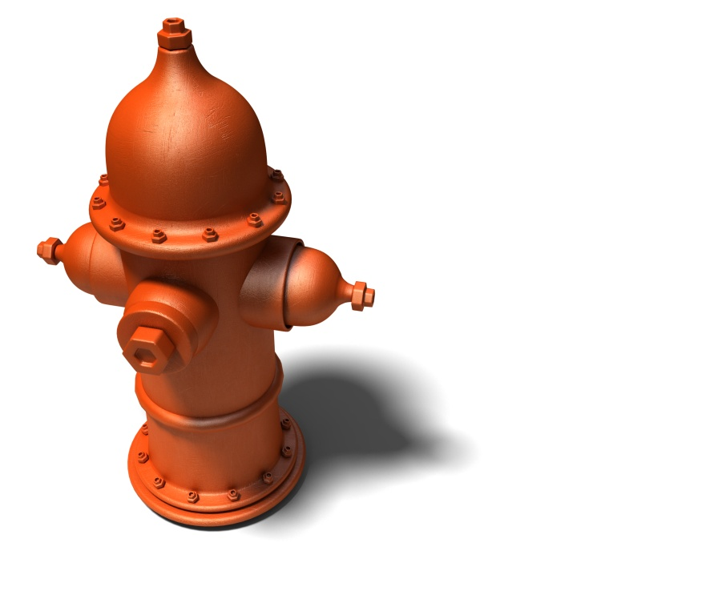
3.1. Central IDEAS
A. UTILITY COMPUTING
One service provisioning model
Service provider makes computing resources and infrastructure management available to the customer as needed, and charges them for specific usage rather than a flat rate.
Like other types of on-demand computing , the utility model seeks to maximize the efficient use of resources and/or minimize associated costs.
Notes:
Utility computing is a service provisioning model in which a service provider makes computing resources and infrastructure management available to the customer as needed, and charges them for specific usage rather than a flat rate. Like other types of on demand computing (such as Grid Computing), the utility model seeks to maximize the efficient use of resources and/or minimize associated costs.
The word utility is used to make an analogy to other services, such as electrical power, that seek to meet fluctuating customer needs, and charge for the resources based on usage rather than on a flat-rate basis. This approach, sometimes known as pay-per-use or metered services is becoming increasingly common in enterprise computing and is sometimes used for the consumer market as well, for Internet service, Web site access, file sharing, and other applications.
Another version of utility computing is carried out within an enterprise. In a shared pool utility model, an enterprise centralizes its computing resources to serve a larger number of users without unnecessary redundancy.

Slide 10
3.1. Central IDEAS contd…
B. SERVICE ORIENTED ARCHITECTURE(SOA)
Service-oriented architecture (SOA) is a style of software design where services are provided to the other components by application components, through a communication protocol over a network. The basic principles of service-oriented architecture are independent of vendors, products and technologies.
Services are what you connect together using Web Services. A service is the endpoint of a connection. Also, a service has some type of underlying computer system that supports the connection offered such as retrieving a credit card statement online.
A service is a function that is
well-defined
self-contained
does not depend on the context or state of other services.
Notes:
The Web is the primary interface through which cloud computing delivers its services. At present, the Web encompasses a set of technologies and services that facilitate interactive information sharing, collaboration, user-centered design, and application composition. This evolution has trans-formed the Web into a rich platform for application development and is known as Web 2.0.
Web 2.0 brings interactivity and flexibility into Web pages, providing enhanced user experience by gaining Web-based access to all the functions that are normally found in desktop applications. These capabilities are obtained by integrating a collection of standards and technologies such as XML, Asynchronous JavaScript and XML (AJAX), Web Services, and others. These technologies allow us to build applications leveraging the contribution of users, who now become providers of content.
Furthermore, the capillary diffusion of the Internet opens new opportunities and markets for the Web, the services of which can now be accessed from a variety of devices: mobile phones, car dashboards, TV sets, and others. These new scenarios require an increased dynamism for appli-cations, which is another key element of this technology. Web 2.0 applications are extremely dynamic: they improve continuously, and new updates and features are integrated at a constant rate by following the usage trend of the community. There is no need to deploy new software releases on the installed base at the client side. Users can take advantage of the new software features sim-ply by interacting with cloud applications.
Examples of Web 2.0 applications are Google Documents, Google Maps, Flickr, Facebook, Twitter, YouTube, Blogger, and Wikipedia. In particular, social networking Websites take the biggest advantage of Web 2.0. The level of interaction in Websites such as Facebook or Flickr would not have been possible without the support of AJAX, Really Simple Syndication (RSS), and other tools that make the user experience incredibly interactive.
From a social perspective, Web 2.0 applications definitely contributed to making people more accustomed to the use of the Internet in their everyday lives and opened the path to the acceptance of cloud computing as a paradigm, whereby even the IT infrastructure is offered through a Web interface.

Slide 11
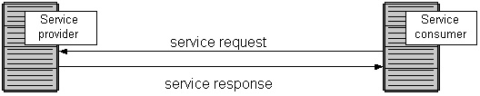
3.1. Central IDEAS contd…
B. SERVICE ORIENTED ARCHITECTURE(SOA)
The technology of Web Services is the most likely connection technology of service-oriented architectures.
Service consumer at the right sending a service request message to a service provider at the left. The service provider returns a response message to the service consumer.
The request and subsequent response connections are defined in some way that is understandable to both the service consumer and service provider. A service provider can also be a service consumer.
Notes:
Service orientation is the core reference model for cloud computing systems. This approach adopts the concept of services as the main building blocks of application and system development. Service-oriented computing (SOC) supports the development of rapid, low-cost, flexible, interoperable, and evolvable applications and systems .
A service is an abstraction representing a self-describing and platform-agnostic component that can perform any function—anything from a simple function to a complex business process. Virtually any piece of code that performs a task can be turned into a service and expose its functionalities through a network-accessible protocol. A service is supposed to be loosely coupled, reusable, programming language independent, and location transparent.
Loose coupling allows services to serve different scenarios more easily and makes them reusable.
Independence from a specific platform increases services accessibility. Thus, a wider range of clients, which can look up services in global registries and consume them in a location-transparent manner, can be served.
Services are composed and aggregated into a service-oriented architecture (SOA), which is a logical way of organizing software systems to provide end users or other entities distributed over the network with services through published and discoverable interfaces.
One of the most popular expressions of service orientation is represented by Web Services (WS) .
These introduce the concepts of SOC into the World Wide Web, by making it consumable by applications and not only humans.
Web services are software components that expose functionalities accessible using a method invocation pattern that goes over the HyperText Transfer Protocol (HTTP). The interface of a Web service can be programmatically inferred by metadata expressed through the Web Service Description Language (WSDL) ; this is an XML language that defines the characteristics of the service and all the methods, together with parameters, descriptions, and return type, exposed by the service.
The interaction with Web services happens through Simple Object Access Protocol (SOAP). This is an XML language that defines how to invoke a Web service method and collect the result.
Using SOAP and WSDL over HTTP, Web services become platform independent and accessible to the World Wide Web. The standards and specifications concerning Web services are controlled by the World Wide Web Consortium (W3C). Among the most popular architectures for developing Web services we can note ASP.NET and Axis

Slide 12
3.1. Central IDEAS contd…
C. SERVICE LEVEL AGREEMENTS
A service-level agreement (SLA) is a contract between a network service provider and a customer that specifies, usually in measurable terms (QoS), what services the network service provider will furnish.
Common content in contract:
Performance guarantee metrics
Up-time and down-time ratio
System throughput
Response time
Problem management detail
Penalties for non-performance
Documented security capabilities

Slide 13

3.1. Central IDEAS contd…
Quality of Service (QoS) is a set of technologies for managing network traffic in a cost effective manner to enhance user experiences for home and enterprise environments.
Now QoS becomes to a broad term that is used following areas :
Customer care evaluations
Technological evaluations
Customer care evaluations
QoS is usually measured in terms of issues that have a direct impact on the
experience of the customer
Only issues that produce a negative effect on the goods and services received
by the customer come under scrutiny
Technological evaluations
QoS has to do with the efficient operation of various systems.
This can lead to adjusting procedures or adapting software programs and code to achieve the desired effect while making a more efficient use of available resources

Slide 14
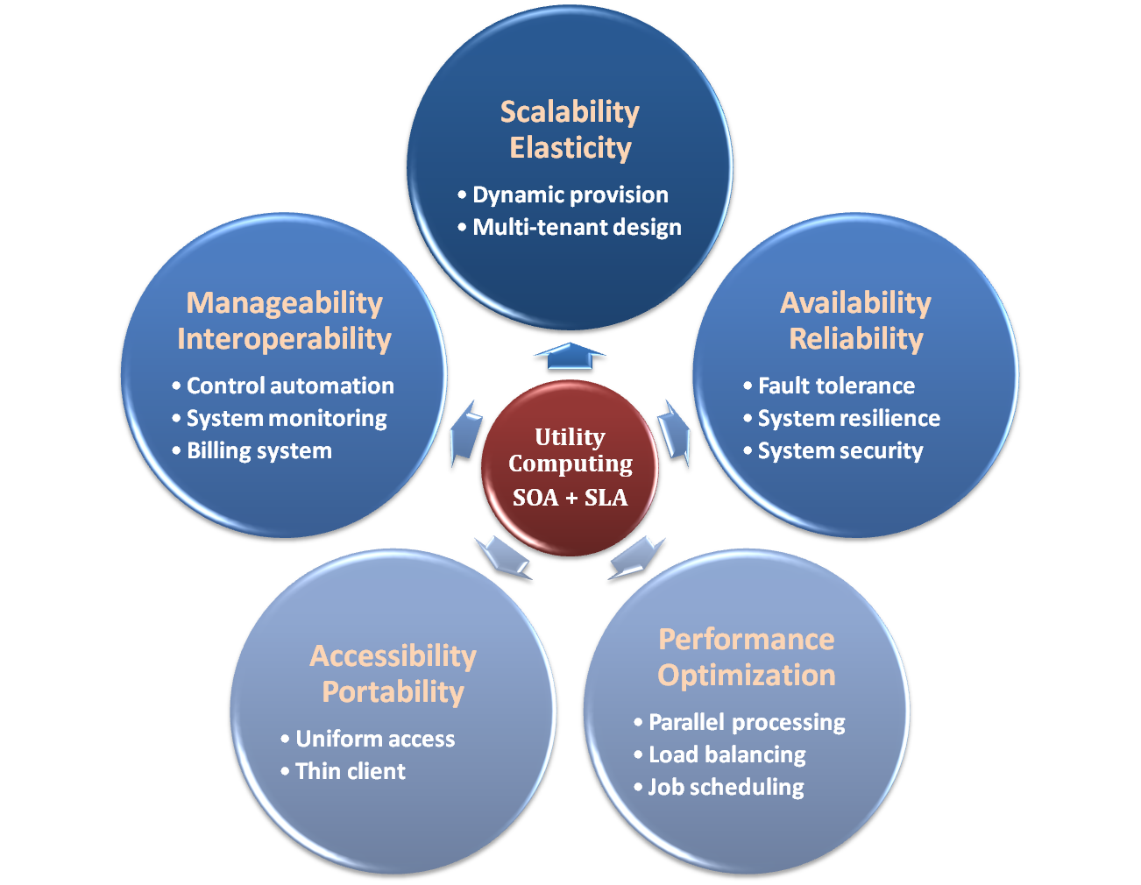

3.2. Characteristics of Cloud computing

Slide 15
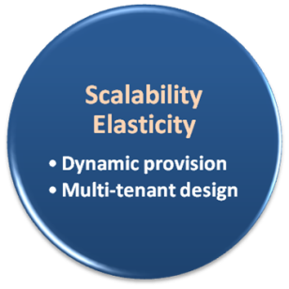
3.2.1 Scalability & Elasticity
What is scalability ?
A desirable property of a system, a network, or a process, which indicates its ability to either handle growing amounts of work in a graceful manner or to be readily enlarged.(Scale up + scale out)
What is elasticity ?
The ability to apply a quantifiable methodology that allows for the basis of an adaptive introspection with in a real time infrastructure.(scale out)
But how to achieve these properties ?
Dynamic provisioning
Multi-tenant design
Notes:
Scalability is the ability of the system to accommodate larger loads just by adding resources either making hardware stronger (scale up) or adding additional nodes (scale out).
Elasticity is the ability to fit the resources needed to cope with loads dynamically usually in relation to scale out. So that when the load increases you scale by adding more resources and when demand wanes you shrink back and remove unneeded resources. Elasticity is mostly important in Cloud environments where you pay-per-use and don't want to pay for resources you do not currently need on the one hand, and want to meet rising demand when needed on the other hand.

Slide 16
3.2.1 Scalability & Elasticity contd…
3.2.1.1. DYNAMIC PROVISIONING
What is dynamic provisioning ?
Dynamic Provisioning is a simplified way to explain a complex networked server computing environment where server computing instances are provisioned or deployed from a administrative console or client application by the server administrator, network administrator, or any other enabled user.

Slide 17
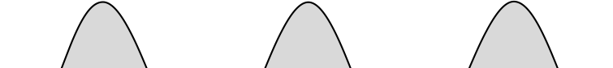
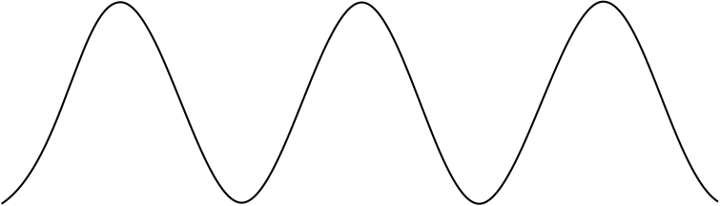
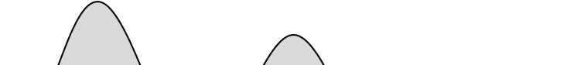

3.2.1 Scalability & Elasticity contd…
3.2.1.1. DYNAMIC PROVISIONING
In traditional computing model, two common problems :
Underestimate system utilization which result in under provision
Loss Revenue
Resources
Capacity
Resources
Demand
Capacity
1
2
3
Demand
Loss Users
Resources
Capacity
1
2
3
Time (days)
Demand
1
2
3

Slide 18
3.2.1 Scalability & Elasticity
3.2.1.1. DYNAMIC PROVISIONING
Overestimate system utilization which result in low utilization
How to solve this problem ??
Dynamically provision resources
Capacity
Resources
Unused resources
Demand
Time

Slide 19
3.2.1 Scalability & Elasticity contd…
3.2.1.1. DYNAMIC PROVISIONING
Cloud resources should be provisioned dynamically
Meet seasonal demand variations
Meet demand variations between different industries
Meet burst demand for some extraordinary events
Resources
Capacity
Resources
Capacity
Demand
Demand
Time
Time

Slide 20
3.2.1 Scalability & Elasticity contd…
3.2.1.2 MULTI TENANT DESIGN
What is multi-tenant design ?
Multi-tenant refers to a principle in software architecture where a single instance of the software runs on a server, serving multiple client organizations.
With a multi-tenant architecture, a software application is designed to virtually partition its data and configuration thus each client organization works with a customized virtual application instance.
Client oriented requirements :
Customization
Multi-tenant applications are typically required to provide a high degree of customization to support each target organization's needs.
Quality of service
Multi-tenant applications are expected to provide adequate levels of security and robustness.
Notes:
Multi-tenancy is an architecture in which a single instance of a software application serves multiple customers. Each customer is called a tenant. Tenants may be given the ability to customize some parts of the application, such as color of the user interface (UI) or business rules, but they cannot customize the application's code.
Multi-tenancy can be economical because software development and maintenance costs are shared. It can be contrasted with single-tenancy, an architecture in which each customer has their own software instance and may be given access to code. With a multi-tenancy architecture, the provider only has to make updates once. With a single-tenancy architecture, the provider has to touch multiple instances of the software in order to make updates.
In cloud computing, the meaning of multi-tenancy architecture has broadened because of new service models that take advantage of virtualization and remote access. A software-as-a-service (SaaS) provider, for example, can run one instance of its application on one instance of a database and provide web access to multiple customers. In such a scenario, each tenant's data is isolated and remains invisible to other tenants.
Single Tenancy
Single-tenant architecture, as the very name suggests, is a system wherein each customer has their own independent database and instance of the software. It is a scenario wherein only a single instance of software is allowed to run on the SaaS server per client. This sort of tenancy implies that there’s essentially no sharing of any instance among clients.
Though not many SaaS providers today offer single-tenant SaaS, security, data backup, and ease of migration to a self-hosted environment are some advantages that this architecture ensures.
Multi-Tenancy
Multi-tenant SaaS tenancy, on the other hand, implies centralized administration to maintain a common code-based application and run a common instance(s) of the application for multiple tenants (organizations/businesses). However, the confidential data for each tenant is secured from any other tenant.
Apart from the software application, each customer also shares a multi-tenant database. As for the data, each set of data is tagged as belonging to each customer. The software is pre-programmed to segregate and secure the data for each user.

Slide 21
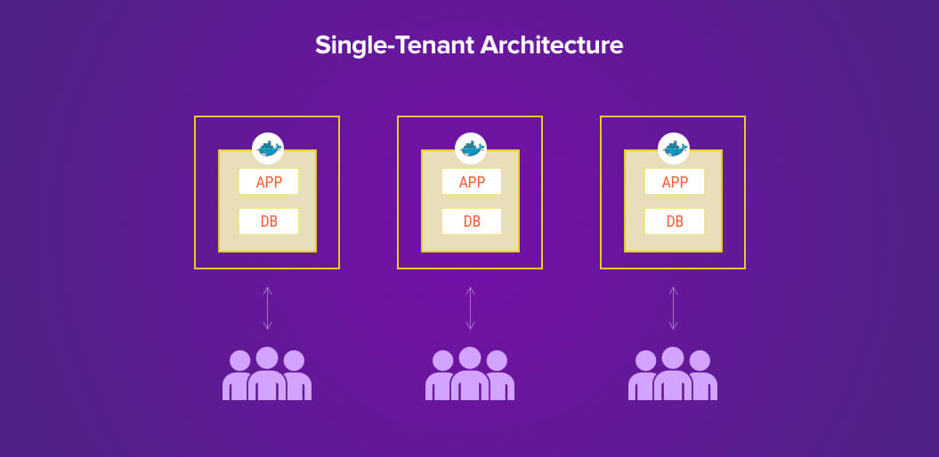
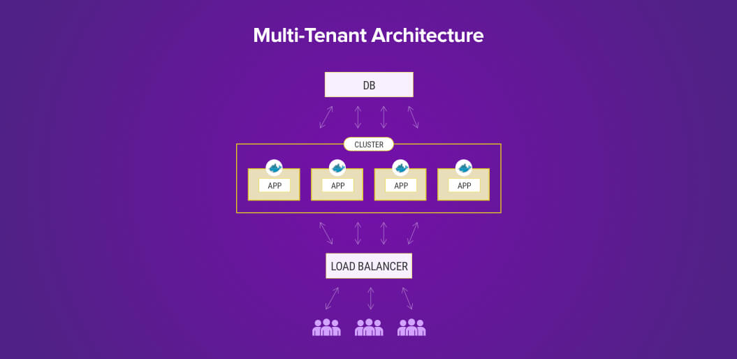

Slide 22
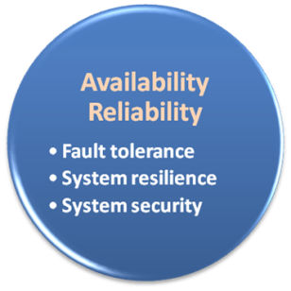
3.2.2. Availability and reliability
What is availability ?
The degree to which a system, subsystem, or equipment is in a specified operable and committable state at the start of a mission, when the mission is called for at an unknown time.
Cloud system usually require high availability
Ex. “Five Nines” system would statistically provide 99.999% availability
What is reliability ?
The ability of a system or component to perform its required functions under stated conditions for a specified period of time.
But how to achieve these properties ?
Fault tolerance system
Require system resilience
Reliable system security
Notes:
Availability is a measure of the % of time the equipment is in an operable state while reliability is a measure of how long the item performs its intended function. We can refine these definitions by considering the desired performance standards.
Availability is an Operations parameter as, presumably, if the equipment is available 85% of the time, we are producing at 85% of the equipment's technical limit. This usually equates to the financial performance of the asset. Of course quality and machine speed need to be considered in order to have a proper representation of how close we are to this technical limit. This is called OEE. Availability can be measured as: Uptime / Total time (Uptime + Downtime).
Reliability is a measure of the probability that an item will perform its intended function for a specified interval under stated conditions. There are two commonly used measures of reliability:
* Mean Time Between Failure (MTBF), which is defined as: total time in service / number of failures * Failure Rate (λ), which is defined as: number of failures / total time in service.

Slide 23
3.2.2. Availability and reliability contd…
3.2.2.1. FAULT TOLERANCE
Fault-tolerance is the property that enables a system to continue operating properly in the event of the failure of some of its components.
If its operating quality decreases at all, the decrease is proportional to the severity of the failure, as compared to a naively-designed system in which even a small failure can cause total breakdown.
Four basic characteristics :
No single point of failure
Fault detection and isolation to the failing component
Fault containment to prevent propagation of the failure
Availability of reversion modes

Slide 24
3.2.2. Availability and reliability contd…
3.2.2.1. FAULT TOLERANCE
Single Point Of Failure (SPOF)
A part of a system which, if it fails, will stop the entire system from working.
The assessment of a potentially single location of failure identifies the critical components of a complex system that would provoke a total systems failure in case of malfunction.
Preventing single point of failure
If a system experiences a failure, it must continue to operate without interruption during the repair process.
Fault Detection and Isolation (FDI)
A subfield of control engineering which concerns itself with monitoring a system, identifying when a fault has occurred and pinpoint the type of fault and its location.
Isolate failing component
When a failure occurs, the system must be able to isolate the failure to the offending component.

Slide 25
3.2.2. Availability and reliability contd…
3.2.2.1. FAULT TOLERANCE
Fault Containment
Some failure mechanisms can cause a system to fail by propagating the failure to the rest of the system.
Mechanisms that isolate a rogue transmitter or failing component to protect the system are required.
Available of reversion modes
System should be able to maintain some check points which can be used in managing the state changes.

Slide 26
3.2.2. Availability and reliability contd…
3.2.2.2 SYSTEM RESILIENCE
What is resilience ?
Resilience is the ability to provide and maintain an acceptable level of service in the face of faults and challenges to normal operation.
Resiliency pertains to the system's ability to return to its original state after encountering trouble. In other words, if a risk event knocks a system offline, a highly resilient system will return back to work and function as planned as soon as possible.
Some risk events
If power is lost at a plant for two days, can our system recover ?
If a key service is lost because of a database corruption, can the business recover ?

Slide 27
3.2.2. Availability and reliability contd…
3.2.2.2 SYSTEM RESILIENCE
Disaster Recovery
Disaster recovery is the process, policies and procedures related to preparing for recovery or continuation of technology infrastructure critical to an organization after a natural or human-induced disaster.
Some common strategies :
Backup
Make data off-site at regular interval
Replicate data to an off-site location
Replicate whole system
Preparing
Local mirror systems
Surge protector
Uninterruptible Power Supply (UPS)

Slide 28
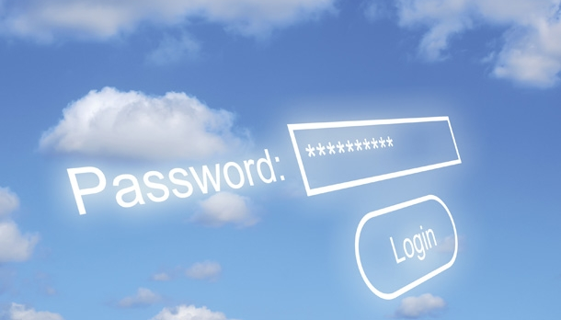
3.2.2. Availability and reliability contd…
3.2.2.3 SYSTEM SECURITY
Security issues in Cloud Computing :
Cloud security is an evolving sub-domain of computer security, network security, and, more broadly, information security.
It refers to a broad set of policies, technologies, and controls deployed to protect data, applications, and the associated infrastructure of cloud computing.

Slide 29
3.2.2. Availability and reliability contd…
3.2.2.3 SYSTEM SECURITY
Important security and privacy issues :
Data Protection
To be considered protected, data from one customer must be properly segregated from that of another.
Identity Management
Every enterprise will have its own identity management system to control access to information and computing resources.
Application Security
Cloud providers should ensure that applications available as a service via the cloud are secure.
Privacy
Providers ensure that all critical data are masked and that only authorized users have access to data in its entirety.

Slide 30
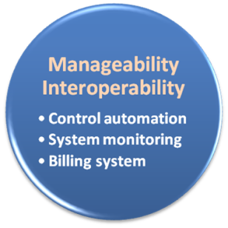
3.2.3. Manageability and Interoperability
What is manageability ?
Enterprise-wide administration of cloud computing systems. Systems manageability is strongly influenced by network management initiatives in telecommunications.
What is interoperability ?
Interoperability is a property of a product or system, whose interfaces are completely understood, to work with other products or systems, present or future, without any restricted access or implementation.
But how to achieve these properties ?
System control automation
System state monitoring

Slide 31
3.2.3. Manageability and operability CONTD…
3.2.3.1. CONTROL AUTOMATION
What is Autonomic Computing ?
Its ultimate aim is to develop computer systems capable of self-management, to overcome the rapidly growing complexity of computing systems management, and to reduce the barrier that complexity poses to further growth.
Architectural framework :
Composed by Autonomic Components (AC) which will interact with each other.
An AC can be modeled in terms of two main control loops (local and global) with sensors (for self-monitoring), effectors (for self-adjustment), knowledge and planer/adapter for exploiting policies based on self- and environment awareness.

Slide 32
3.2.3. Manageability and operability CONTD…
3.2.3.1. CONTROL AUTOMATION
Four functional areas :
Self-Configuration
Automatic configuration of components.
Self-Healing
Automatic discovery, and correction of faults.
Self-Optimization
Automatic monitoring and control of resources to ensure the optimal functioning with respect to the defined requirements.
Self-Protection
Proactive identification and protection from arbitrary attacks.

Slide 33
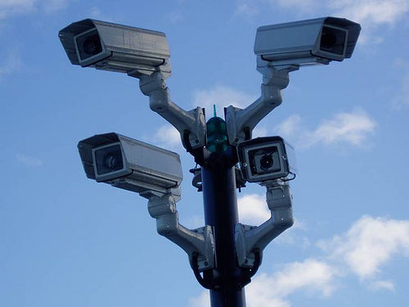
3.2.3. Manageability and Interoperability CONTD…
3.2.3.2. SYSTEM MONITORING
What is system monitor ?
A System Monitor in systems engineering is a process within a distributed system for collecting and storing state data.
What should be monitored in the Cloud ?
Physical and virtual hardware state
Resource performance metrics
Network access patterns
System logs
… etc.
Anything more ?
Billing System

Slide 34

3.2.3. Manageability and Interoperability CONTD…
3.2.3.3 BILLING SYSTEM
Billing System in Cloud
Users pay as many as they used.
Cloud provider must first determine the list of service usage price.
Cloud provider have to record the resource or service usage of each user, and then charge users by these records.
How can cloud provider know users’ usage ?
Get those information by means of monitoring system.
Automatically calculate the total amount of money which user should pay. And automatically request money from use’s banking account.

Slide 35
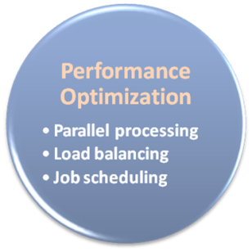
3.2.4 Performance and optimization
Performance guarantees ??
As the great computing power in cloud, application performance should be guaranteed.
Cloud providers make use of powerful infrastructure or other underlining resources to build up a highly performed and highly optimized environment, and then deliver the complete services to cloud users.
But how to achieve this property ?
Parallel computing
Load balancing
Job scheduling

Slide 36
3.2.4 Performance and optimization contd…
3.2.4.1 PARALLEL PROCESSING
Parallel Processing
Parallel processing is a form of computation in which many calculations are carried out simultaneously, operating on the principle that large problems can often be divided into smaller ones, which are then solved concurrently.
Parallelism in different levels :
Bit level parallelism
Instruction level parallelism
Data level parallelism
Task level parallelism

Slide 37

3.2.4 Performance and optimization contd…
3.2.4.2. LOAD BALANCING
What is load balancing ?
Load balancing is a technique to distribute workload evenly across two or more computers, network links, CPUs, hard drives, or other resources, in order to get optimal resource utilization, maximize throughput, minimize response time, and avoid overload.
Why should be load balanced ?
Improve resource utilization
Improve system performance
Improve energy efficiency
Unbalanced

Slide 38
3.2.4 Performance and optimization contd…
3.2.4.2. JOB SCHEDULING
What is job scheduler ?
A job scheduler is a software application that is in charge of unattended background executions, commonly known for historical reasons as batch processing.
What should be scheduled in Cloud ?
Computation intensive tasks
Dynamic growing and shrinking tasks
Tasks with complex processing dependency
How to approach ?
Use pre-defined workflow
System automatic configuration
Notes:
load balancing is focused on keeping the available resources equally busy and avoid overload of one machine with many tasks. The advantage is not only in terms of using more computational power (because in bad load balancing it can be that all the machines are used but some have many more tasks and one have just a few) but also of spending less time in switching between tasks. It is also usually considering the problem as instantaneous and considering that there are enough resources to work on all the tasks simultaneously
2) scheduling regards deciding the sequence of execution of the task. In this case the assumption that there are enough computational resources for each task fails. Load balancing can be considered as a part of scheduling where time is not considered, but I would see the two approaches as working on two different levels of abstraction, with scheduling not considering switching cost but deciding just which task will be executed, and load balancing as optimising how the selected tasks will be mapped to the resources at each time step.

Slide 39
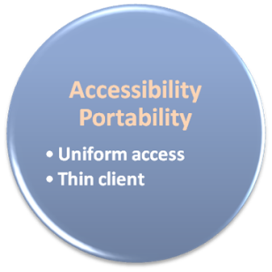

3.2.5. Accessibility and portability
What is accessibility ?
Accessibility is a general term used to describe the degree to which a product, device, service, or environment is accessible by as many people as possible.
What is service portability ?
Service portability is the ability to access services using any devices, anywhere, continuously with mobility support and dynamic adaptation to resource variations.
But how to achieve these properties ?
Uniform access
Thin client

Slide 40
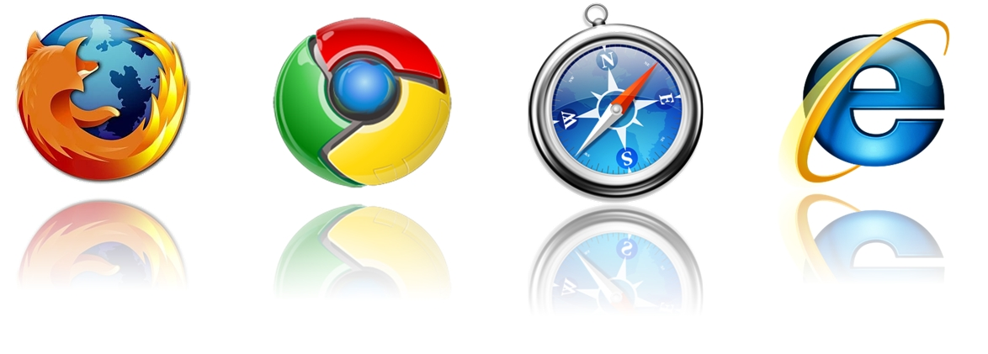
3.2.5. Accessibility and portability
3.2.5.1 UNIFORM ACCESS
How do users access cloud services ?
Cloud provider should provide their cloud service by means of widespread accessing media. In other word, users from different operating systems or other accessing platforms should be able to directly be served.
Nowadays, web browser technique is one of the most widespread platform in almost any intelligent electronic devices. Cloud service take this into concern, and delivery their services with web-based interface through the Internet.

Slide 41
3.2.5. Accessibility and portability contd…
3.2.5.2. THIN CLIENT
What is thin client ?
Thin client is a computer or a computer program which depends heavily on some other computer to fulfill its traditional computational roles. This stands in contrast to the traditional fat client, a computer designed to take on these roles by itself.
Characteristics :
Cheap client hardware
While the cloud providers handle several client sessions at once, the clients can be made out of much cheaper hardware.
Diversity of end devices
End user can access cloud service via plenty of various electronic devices, which include mobile phones and smart TV.
Client simplicity
Client local system do not need complete operational functionalities.

